Slide 1

City of Ocala Leadership Group Meeting
June 23, 2016

Slide 2
Leadership Group Meeting Agenda
Place Based Code
Midtown Master Plan
Website Development Related Mapping
Upcoming meetings
Approval of 5/26 Minutes
Final Comments

Slide 3
Place based Code (PBC)
General Provisions
Policies and Procedures
Development Standards
Design Standards
Definitions

Slide 4
Regulating plan (PBC)
Notes:
Left message with Larry MillerParking Garage
Osceola Linear Trail
Historic District Improvements
Water Main Project: Ft King Street from SE 8th Ave to Watula Avenue (estimated completion 6/22)
Farm Market

Slide 5
DEVELOPMENT STANDARDS (PBC)

Slide 6
DESIGN STANDARDS (PBC)

Slide 7
PEDESTRIAN REALM (PBC)

Slide 8
SIGNAGE (PBC)

Slide 9
Midtown Master Plan

Slide 10
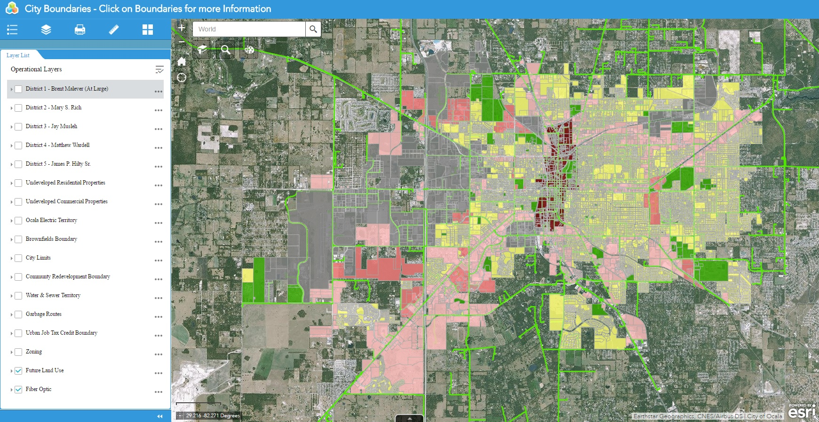
Development Related Mapping
Notes:
Sent email to Matt L

Slide 11

Upcoming Meetings
City Council Meeting
    Thursday, July 7th at 4:00 pm at City Council Chambers
    Tuesday, July 19th at 4:00 pm at City Council Chambers
Ocala Historic Preservation Advisory Board
Thursday, July 7th at 4:00 pm at 2nd Floor CSC Training Room
Planning and Zoning Commission
Monday, July 11th at 5:30 pm at City Council Chambers
Tree Pruning Seminar
Friday, July 8th at 11:00 am at Wellington Station Community Room

Slide 12
Approval of 5/25 minutes

Slide 13
Comments / Questions

